Slide 1
CPMC2020
MBC
-Rules of the Building-

Slide 2
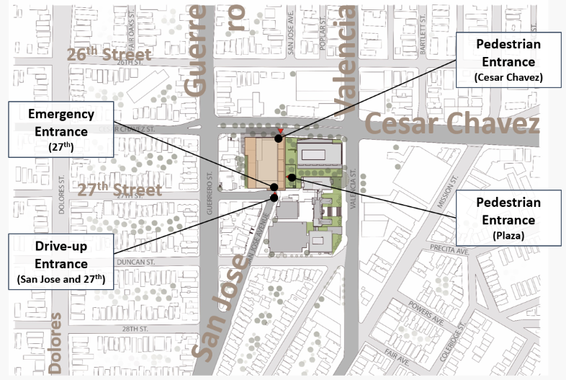
Hospital Overview
Hours of Operation
 | MBC
Hospital Entrance 1. Cesar Chavez 2. 2nd Floor Plaza | 5am – 8pm M-F *Badge reader after hours*
Emergency Entrance | 24/7
Peet’s Coffee Cart (Monteagle Building) | 7:30am-3:00pm M-F *Closed on the weekends*
Cafeteria | Weekdays 6:30a-6:30p *Closed on the weekends and after hours*
Walgreens Pharmacy (Monteagle Building) | Weekdays 9am-6pm *Closed on the weekends*
Loading Dock/Delivery Hours | Monday – Friday 7:00am to 3:00pm. Other hours by appointment only.
Shuttle Pick Up/Drop Off

Slide 3
Badge Access & Entry Overview
Universal/Base Access
Restricted Areas
All exterior doors with card readers
All back of house space (hallways, etc.)
Multidisciplinary/Conference Rooms
Consult Rooms
Bicycle Storage
Locker Rooms
Emergency Department
Imaging Entrance
M/S, L&D and M/S Patient Floors (unless otherwise specified)
Medrooms
Clean/Soil Utility Room
Medical Equipment Rooms
Nourishment Rooms
Food & Nutrition Area
Biomedical Engineering
Pharmacy
Materials Mgmt/Supply Chain
Security
Admitting
Clinical Lab
SPD, OR, PACU/ACU
Nursery/SCN
PT/OT Area
Administrative Suite
PBX
Morgue

Slide 4
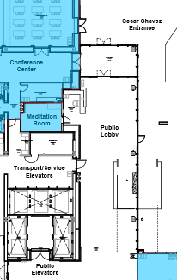
Elevator Usage
Transport/Service Elevators
Total: 3
Users: Employees, Physicians, Patient Transport
Patient being transported will be prioritized and elevators should be made available.
Badge access required!
Public Elevators
Total: 4
Users: Patients and Visitors
Badge access not required

Slide 5
Badge 101
Employees, Volunteers and Physicians
Badge must be worn at all times, many doors will require badge reader to upon entry.
Registry staff will be required to show registry ID before being issued a badge. These need to be return to charge nurse end of shift.
Internal stairwells can be used for exiting the building, however re-entry will be on the ground floor.
Please pay attention to your surroundings and ensure that no one enters behind you when badging in.
If you forgot your badge, please go to the Security Desk for a temporary badge.
Visitors
Visitor badges are required and can be obtained on Level 1 or Level 2 Security Desk.
Photo identification will be required for those 18 years and older.
Children who are coming with their parents can have their photos taken at the security desk for badge issue.
Badges will become VOID after 6-8 hours and will need to be re-issued.

Slide 6
Lost & Found
Current State: 1912 building on the 4th floor
Future State: To be determined

Slide 7
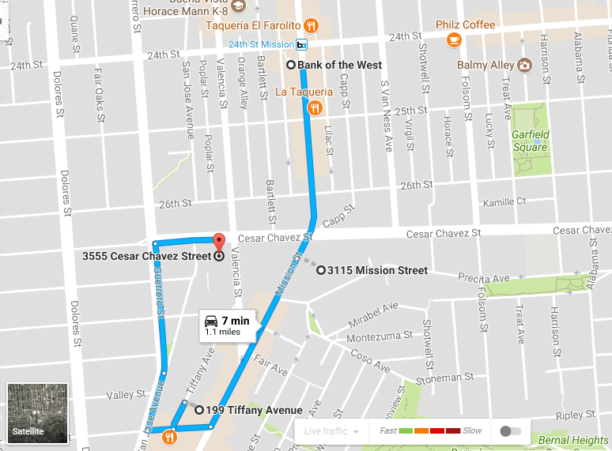
Shuttle Schedule & Routes
NEW MBC24 Shuttle Route!
Shuttle will run between MBC and 24th Mission Bart every 30 minutes all day (0600-1800).
Schedule can be found here.
MBC24 shuttle is available NOW (as of September 2017) for a limited hours (2pm-6pm) until MBC opens its doors.
NEW Offsite Staff Lots
NEW Offsite Staff Lots

Slide 8
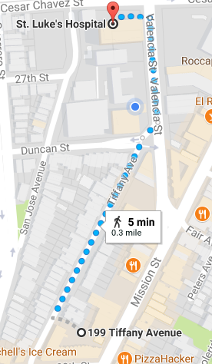
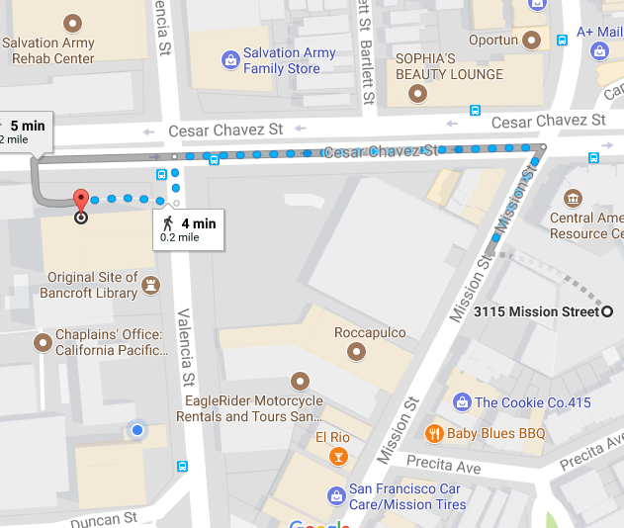
Parking
2 additional parking lots have been made available to provide an additional 40 parking spaces for our employees during business hours.
Cesar Chavez St. Garage will still be made available to all employees after hours and on weekends.
3111 Mission Street Parking Lot
199 Tiffany Avenue Parking Lot
Additional parking lots are approx. 5-minutes away walking from the new hospitals.
Shuttle services are available from 24th Mission Bart, with additional pick up/drop off locations at each parking lot.
Security escorts are available if needed.
NEW Offsite Staff Lot
NEW Offsite Staff Lot

Slide 9
Deliveries
Unless specifically authorized in advance, deliveries are not allowed through the front entrance of the hospital.
Vendors:
Florist, Patient Gifts, etc.: Deliver during business hours only, will come through Cesar Chavez entrance and deliver to front desk lobby for volunteers to bring up.
Morgue: Drivers will be buzzed in from loading dock ramp, mortician will meet security at loading dock ramp (door is badge reader access only) and will be escorted into the morgue by nursing supervisor.
All Others: Short term parking spaces are reserved for vendors in nearby garage for loading and unloading.
Vendors/Delivery Companies arriving after regular hours will contact the Security Department at 414-xxx-xxxx.

Slide 10
Bicycles & Locker Space
All bicycles can be stored on the 1st floor (badge reader access) – First Come First Serve
Storage room is accessible via 1st floor 27th St. or Cesar Chavez front entrance (through conference center corridor)
Employees are encouraged to submit registration form in advanced (to parking office) to secure space and program badge.
No locker available– employees will required to store personal belongings in lockers on their floors
All staff can use 1st floor showers, however items cannot remain stored for day use.

Slide 11
Staff Locker Usage
All lockers will be day use only.
Department manager is responsible for handling locker buddy assignments and distribution.

Slide 12
Loading Dock/Unloading
Hours of Operation: 7:00am-8:00pm
Delivery Hours Include: Monday – Friday 7:00am to 3:00pm. Other hours by appointment only.
Height Restrictions:
Noise Restriction
Traffic Flow Details:
Dock entrance is not to be used as a general employee entrance and is not to be used by employees unless operating one of the authorized hospital vehicles.
Dock locations are for the loading and unloading process and are not to be used for parking.

Slide 13
Room Reservations/Catering Requests
Catering Requests
Reserving Rooms
All catering requests must be submitted to the Food & Nutrition Department three business days in advance of the meeting or event. Approval by department director is required for any catering event that meets the catering guidelines.
A meeting is defined as:
Occur before 8:00am or between the hours of 11:00am-1:00pm; AND
Have a minimum of 10 people in attendance; AND
Are 4 hours or longer in length, OR
Physician attended
A separate request must be submitted for each event (i.e. one for breakfast, one for lunch)
Forms must be submitted with the appropriate signature.
Approval must be obtained by receiving a live signature on catering order.
Typed signatures or approval via email will not be considered appropriate approval.
Recurring events may be submitted on the same form if menus are identical and dates are clearly listed.

Slide 14
Training/Education Schedule
Information to come

Slide 15
Do’s/Don’ts:
Do not adjust things on the building or hang things on the wall for the first 3-months following move in. Moving forward, all pictures, hooks, personal items must be hung by Plant Operations.
Do not bring any live plants into your areas.
No fish or pets of any kind will be permitted.
Do not have your personal packages delivered to this area. material management will not sign for it.

Slide 16
Reminders
Team Members are encouraged to remember that the front lobby is the visitor/patient entrance and the appearance of the area is the first impression of our new facility.
The new hospital will have a front of house (on stage) and back of house (off stage) concept. Front of the house refers to all areas that patients and visitors will be exposed to. In these areas all team members are expected to perform as if they are on stage. Off stage refers to areas that patients and visitors will not be exposed to. Team members will have specific hallways and elevators to use in the new facility. Utilizing this concept will allow us to always shine while we are on stage and create a positive environment for our customers.

Slide 17
Appendix

Slide 18
Water Cooler
Drinking Water Options:
Plumbed coffee makers with hot water dispenser for immediate hot water available on certain floors
Water Coolers Locations:1) PBX room and 2) Inpatient Rehab Gym. There are no provisions for bottle water coolers at VNG.
Ice makers are available in patient nourishment rooms, not in staff lounges.
Drinking Fountain/Fill Locations: Emergency Department, Cafeteria and Surgical Waiting Room
Emergency Water:
VNG will have fully functioning potable water tank at Move-In – do not need to move emergency water stores from Cal or Pac.
MBC will not have fully functioning potable water tank at Move-In – STL will need to move their emergency water stores and keep until the tank is operational.

Slide 19
Non-Badge Reader Doors
On-Call Rooms – key access
Meditation Room

